Slide 1
Unity Overview
26.8.2015

Slide 2
Schedule
9:00 – 10:15: Overview of Unity’s features
10:15 – 10:45: Break
10:45 – 12:30: Hands-on with Unity and a simple VR project!

Slide 3
Why Unity?
Unity is a game engine for 2D and 3D games that allows you to create experiences and games without writing all of the logic and components from scratch.
Standardizes physics, imports, shading, lighting computation, and much more
Robust set of build system tools – can export to nearly any platform
Extensible plug-in system to create add-ons for hardware components
Visual development interface

Slide 4
Unity for VR Development
Unity 5.1 has support for virtual reality development built-in
Oculus, HTC Vive, Cardboard, and most of the peripheral devices have Unity plug-ins to create prefabs, objects that are bundled together to create a more complicated item
Test using VR headsets directly
Some older versions of Unity (generally 4.5+) will support VR SDKs
If you don’t have Unity installed, it is highly recommended that you begin the download now, especially if you think that you may want to use Unity for the final project.

Slide 5
Important Unity Terminology
Scene – A collection of different components that make up a specific environment or level
Game Object – An individual object that is within a game scene
Component – An aspect of a game object that gives it certain properties. This can be related to the way the object “behaves”, or its’ appearance
Script- A code file that gives a game object certain behaviors
Asset – an item that is used within your game (materials, textures, meshes, scripts, etc.)

Slide 6
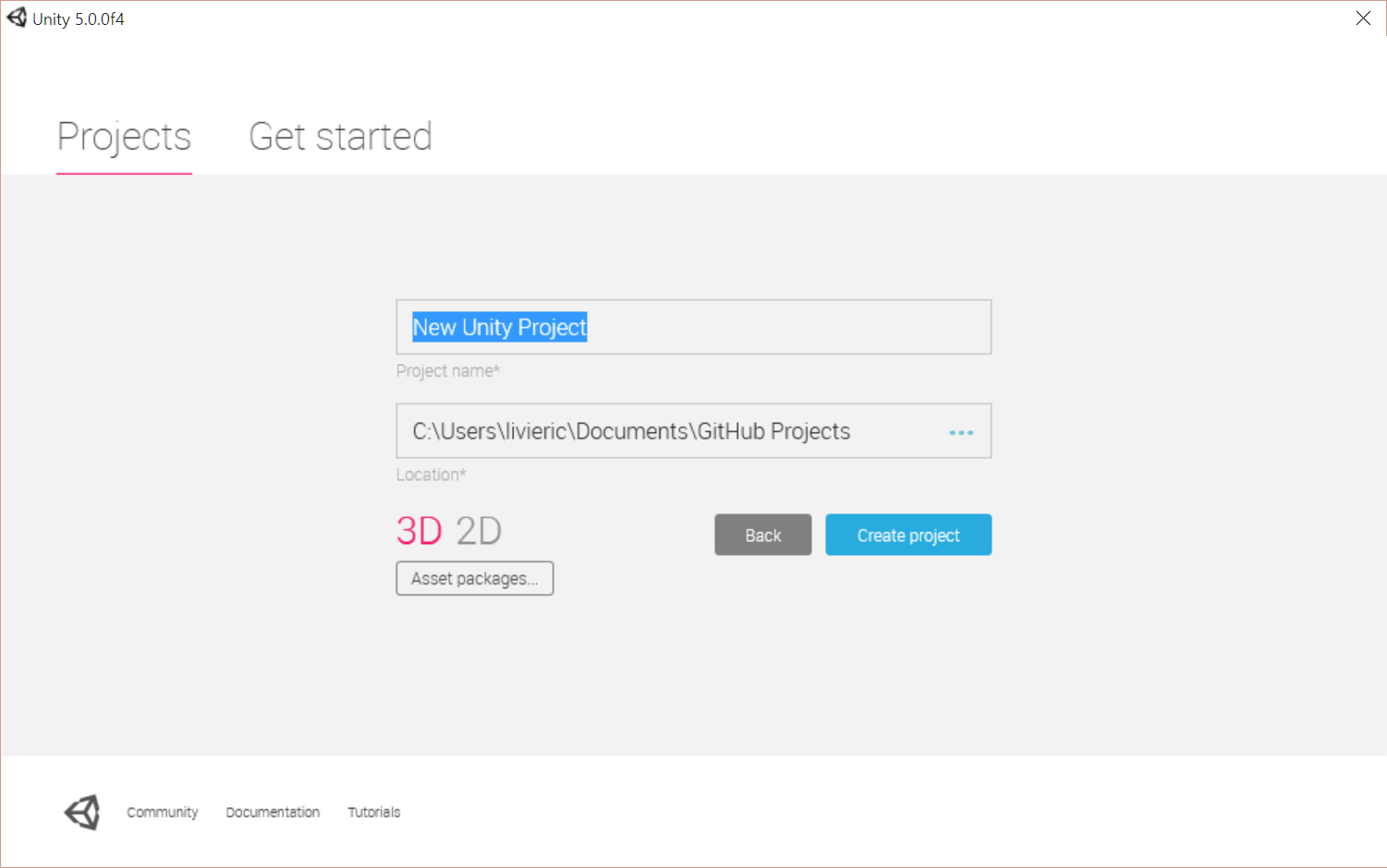
The Basics of a Unity Project
A Unity Project contains all of the required files for making your game / app
For VR, you should select the 3D option
You can add in various asset packages at the start to avoid entering them manually

Slide 7
Creating a Project
Add simple primitive GameObjects to your scene(s)
Create scripts and add behaviors to your objects
Change the mesh objects to more complex items
Add materials and textures to change the appearance of items
Test throughout the process!
Build your project for your desired platform
Play on!

Slide 8
Editor Modes
Create Mode
Game Mode
Modify your scene and view from different angles
View gridlines
Easily modify and move objects around
Non-visible objects are “visible”
Allows you to preview your game without building it to a separate application
You can edit in live-time!
… but changes don’t stick
It’s strongly encouraged to change your game play color in the Unity settings so you don’t make too many changes that don’t stay

Slide 9
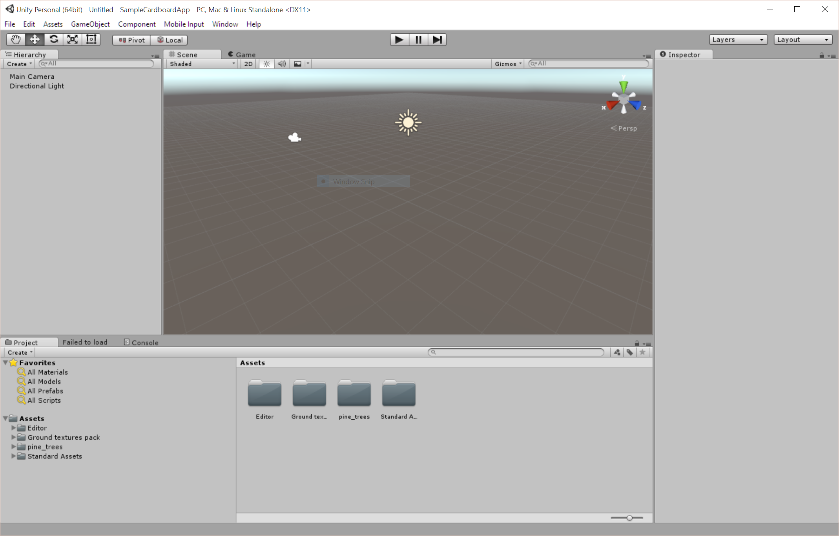
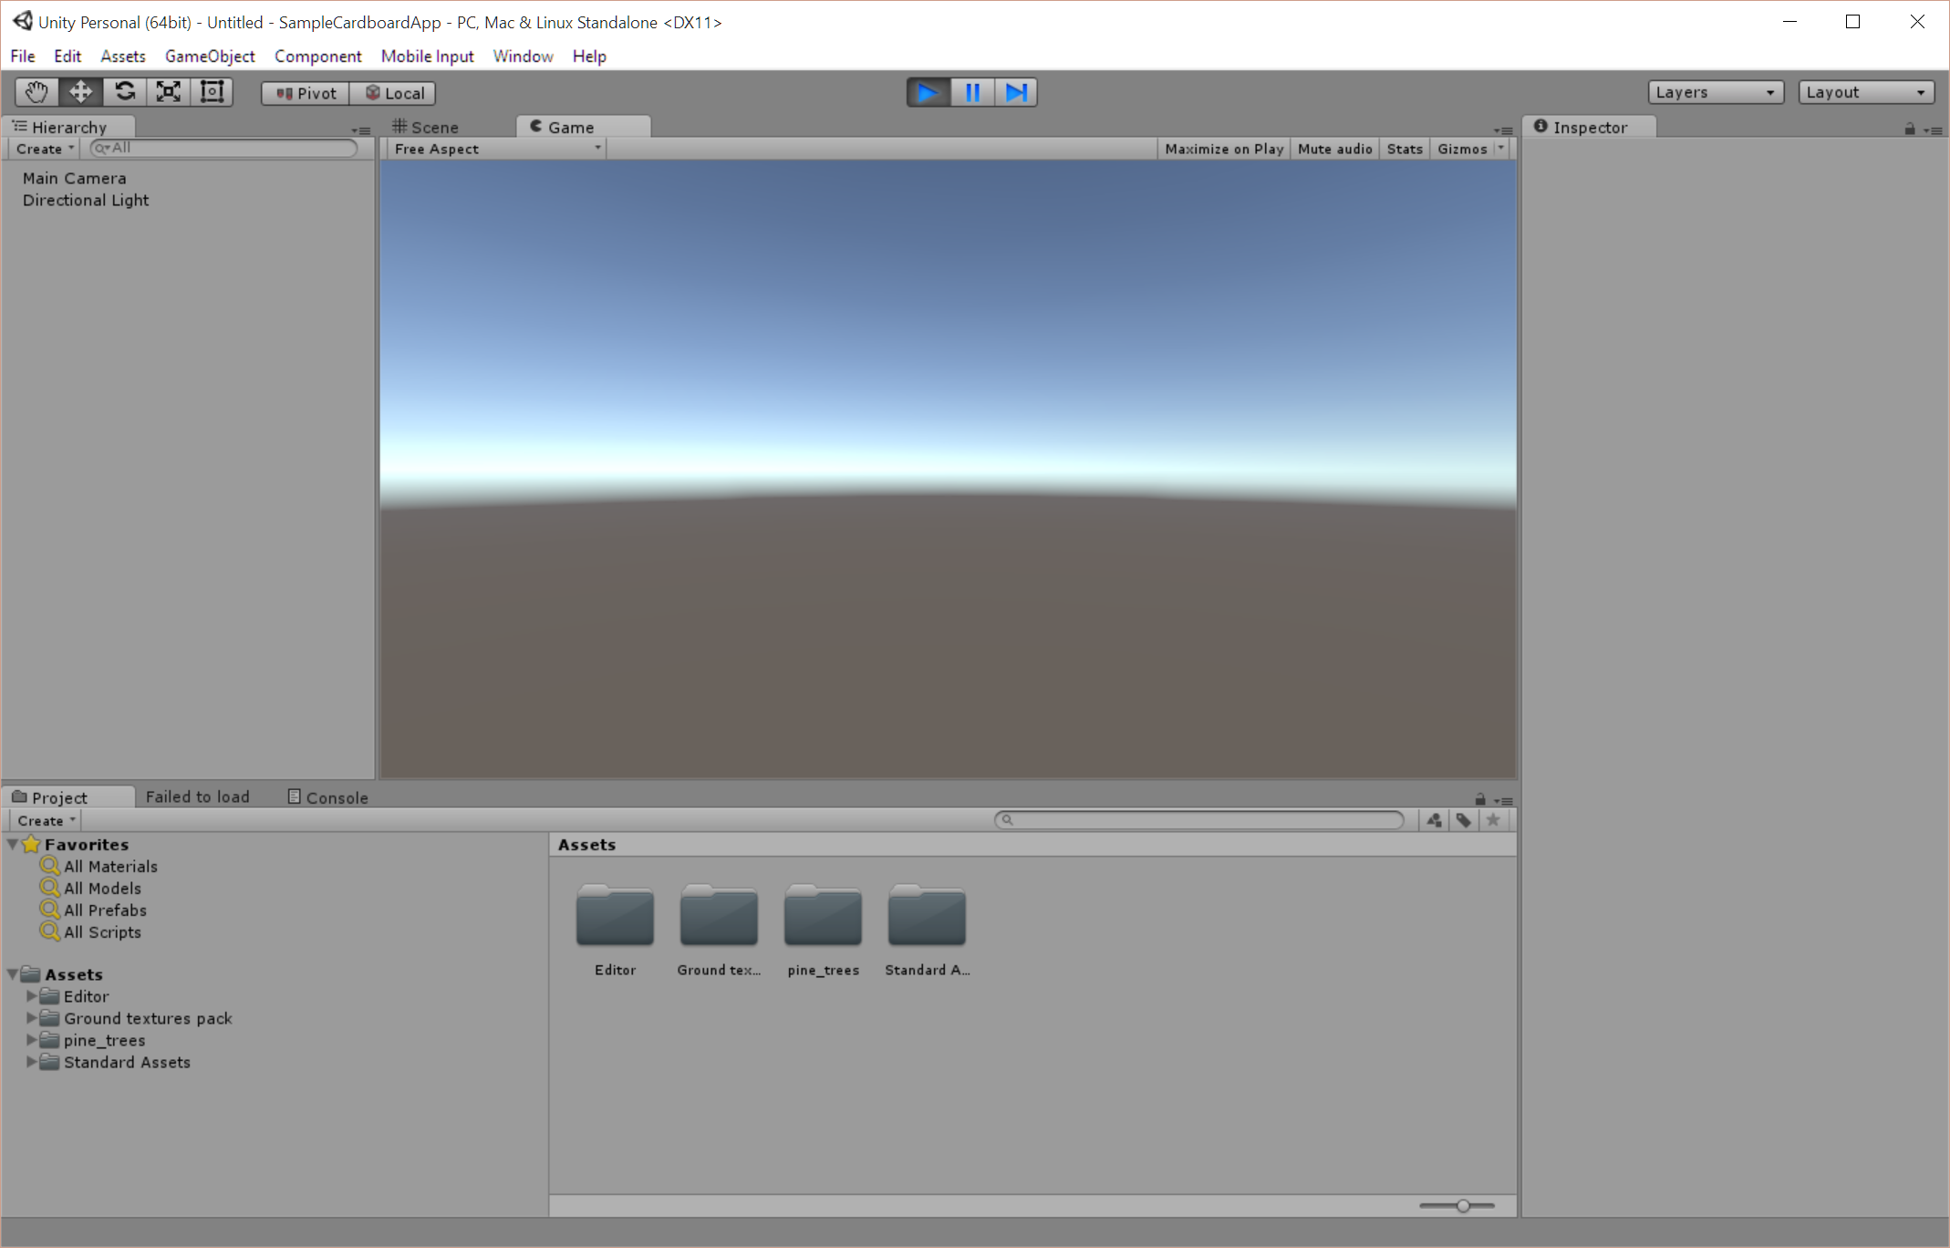

Slide 10
GameObjects

Slide 11
Adding Components to a scene
The first thing you’ll probably want to do when you start your first app is to build a scene!
By default, a camera and simple light source will be included
Within the Unity layout, your hierarchy will show all of the items in your scene
The create drop down menu will let you add new things into your scene

Slide 12
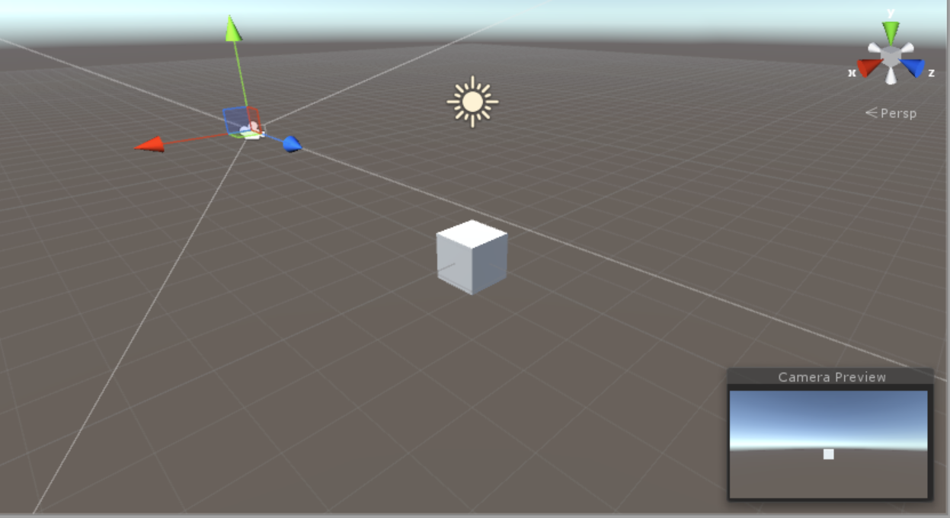
Create a cube
On the hierarchy tab, select Create
Choose 3D Object -> Cube
Click on the Main Camera object to get a small preview of the scene in the lower corner of the game view window. You should see your cube in the distance!

Slide 13
Changing an Object’s Appearance
When we have a mesh item, such as our cube, we will want to change the way it looks. As an example, we might want our cube to be a wooden box, or a brick wall.
Textures and materials are two components that we can apply to an object to change the way they look in our game
Materials define the properties of an object with how light is reflected off of them
Textures are usually image files that create different patterns to make meshes look more complex without adding in new physical elements

Slide 14
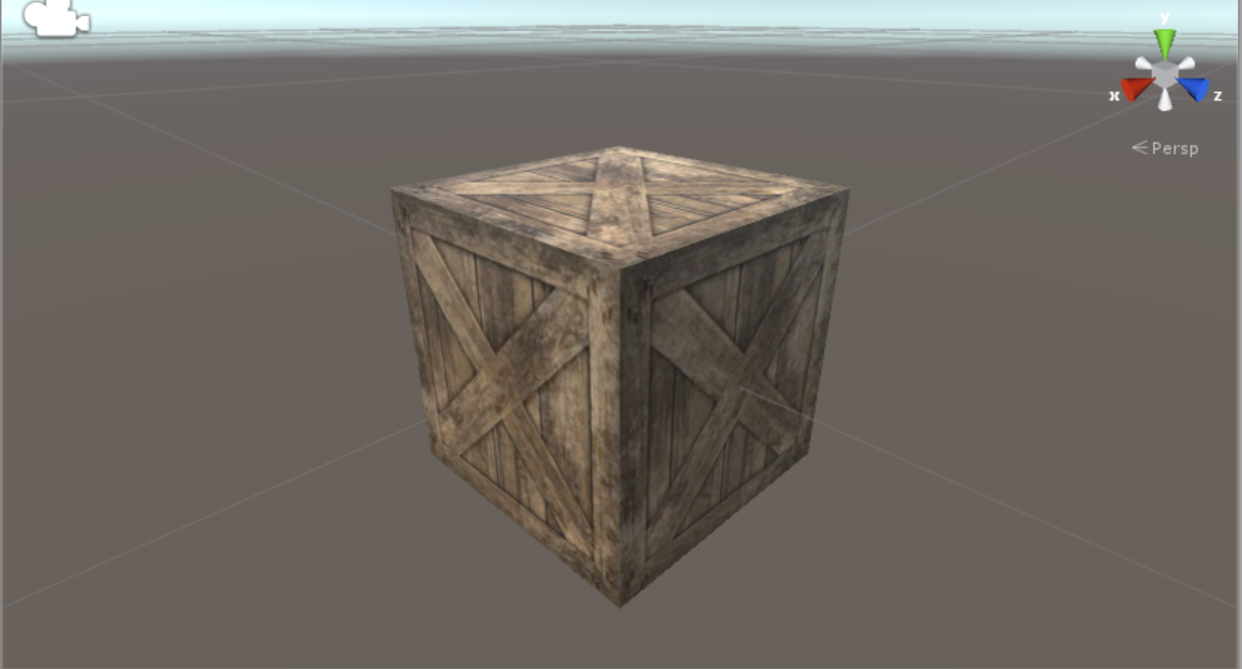
Creating a Texture & Material
We’re going to make our box more interesting by making a new material and texture
We’ve added an image file for our cube in the sample project
In the Assets folder, create a new material for your box
Drag the new material onto the cube
Drag the image file onto the cube

Slide 15
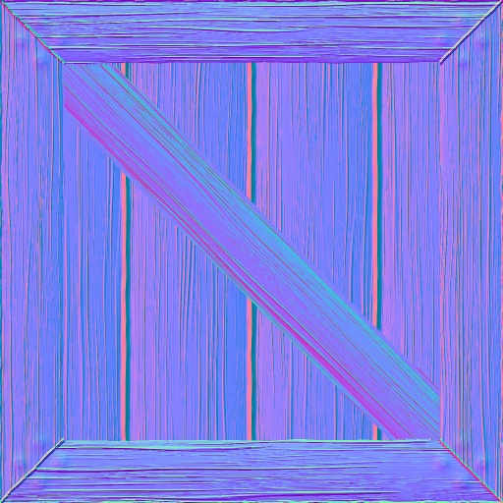
Give it some depth! Normal Maps
A normal map is a special type of image file that tells our program how our cube should appear if it were in 3D
Applying a normal map that matches the texture will give it a detailed appearance to seem more realistic
Assets that are downloaded from the asset store and come with a texture may include normal maps

Slide 16
Adding a normal map to our box
Select the box and expand the material properties on the inspector
Under the material header, find the ‘Normal Map’ option
Drag the desired normal map from the asset folder into the empty spot for the normal map

Slide 17
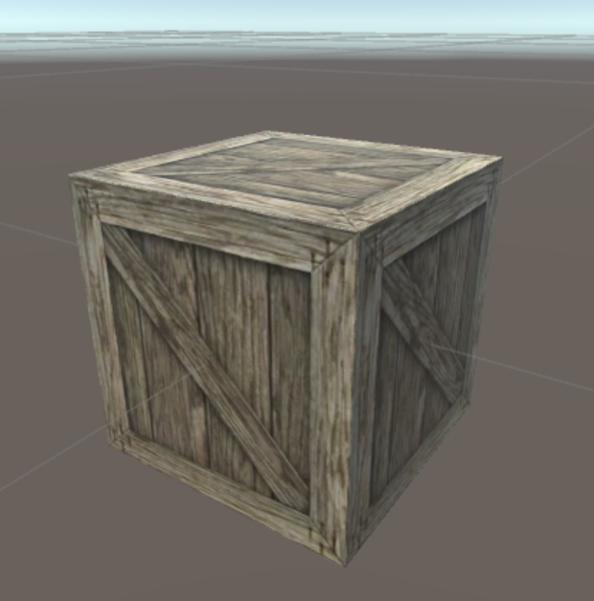
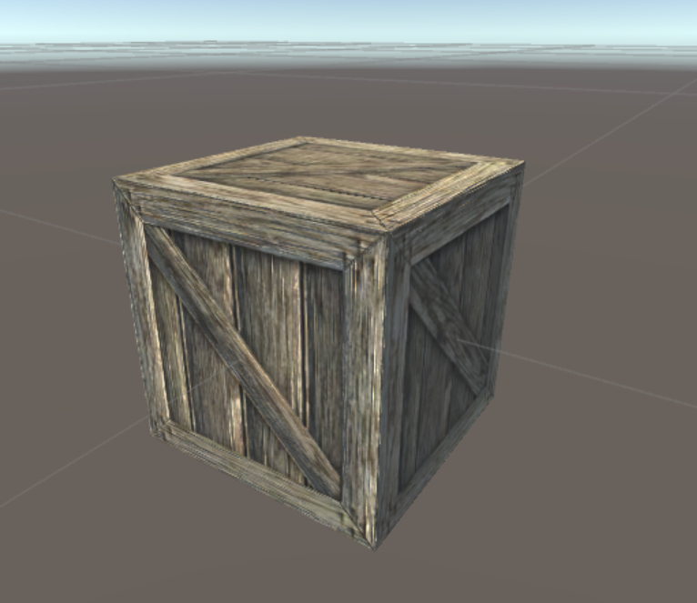
Crate Normal Map
Without Normal Mapping
With Normal Mapping

Slide 18
Game Environments

Slide 19
Building an Environment
A large part of immersive worlds is the environment that surrounds us when we are playing. There are several approaches for environments in Unity:
Open world terrain using the Terrain Editor
Small world environments built from simple game objects
Enclosed room environments built from simple game objects
You may also find complete scene environments on the Asset store

Slide 20
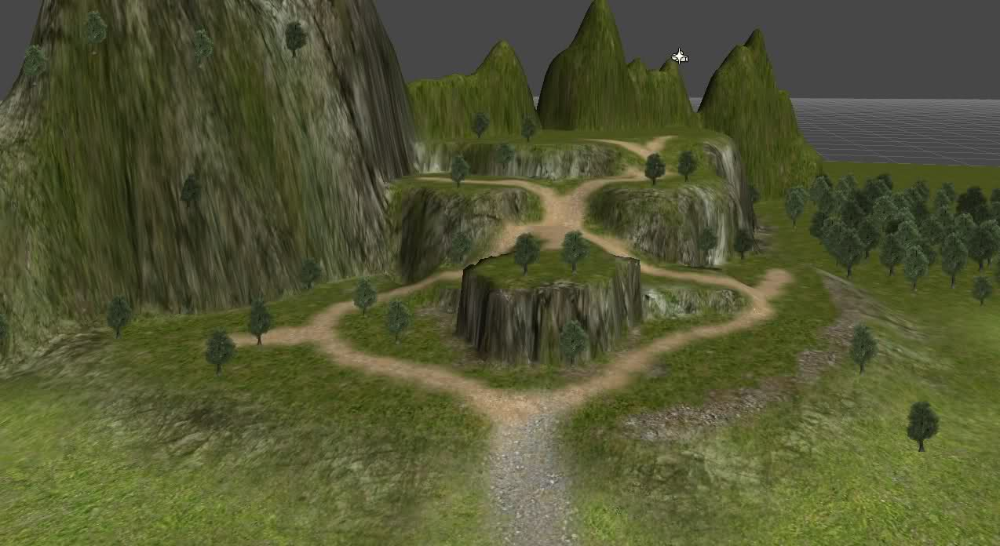
Terrains

Slide 21
Unity Terrain Editor
Very large worlds that can be modified by painting different textures onto the materials
Manipulate the heights of various areas with paint brush
Add trees and other graphics to the terrain via brush strokes
Directly paint texture onto the mesh to create varying looks over the terrain

Slide 22
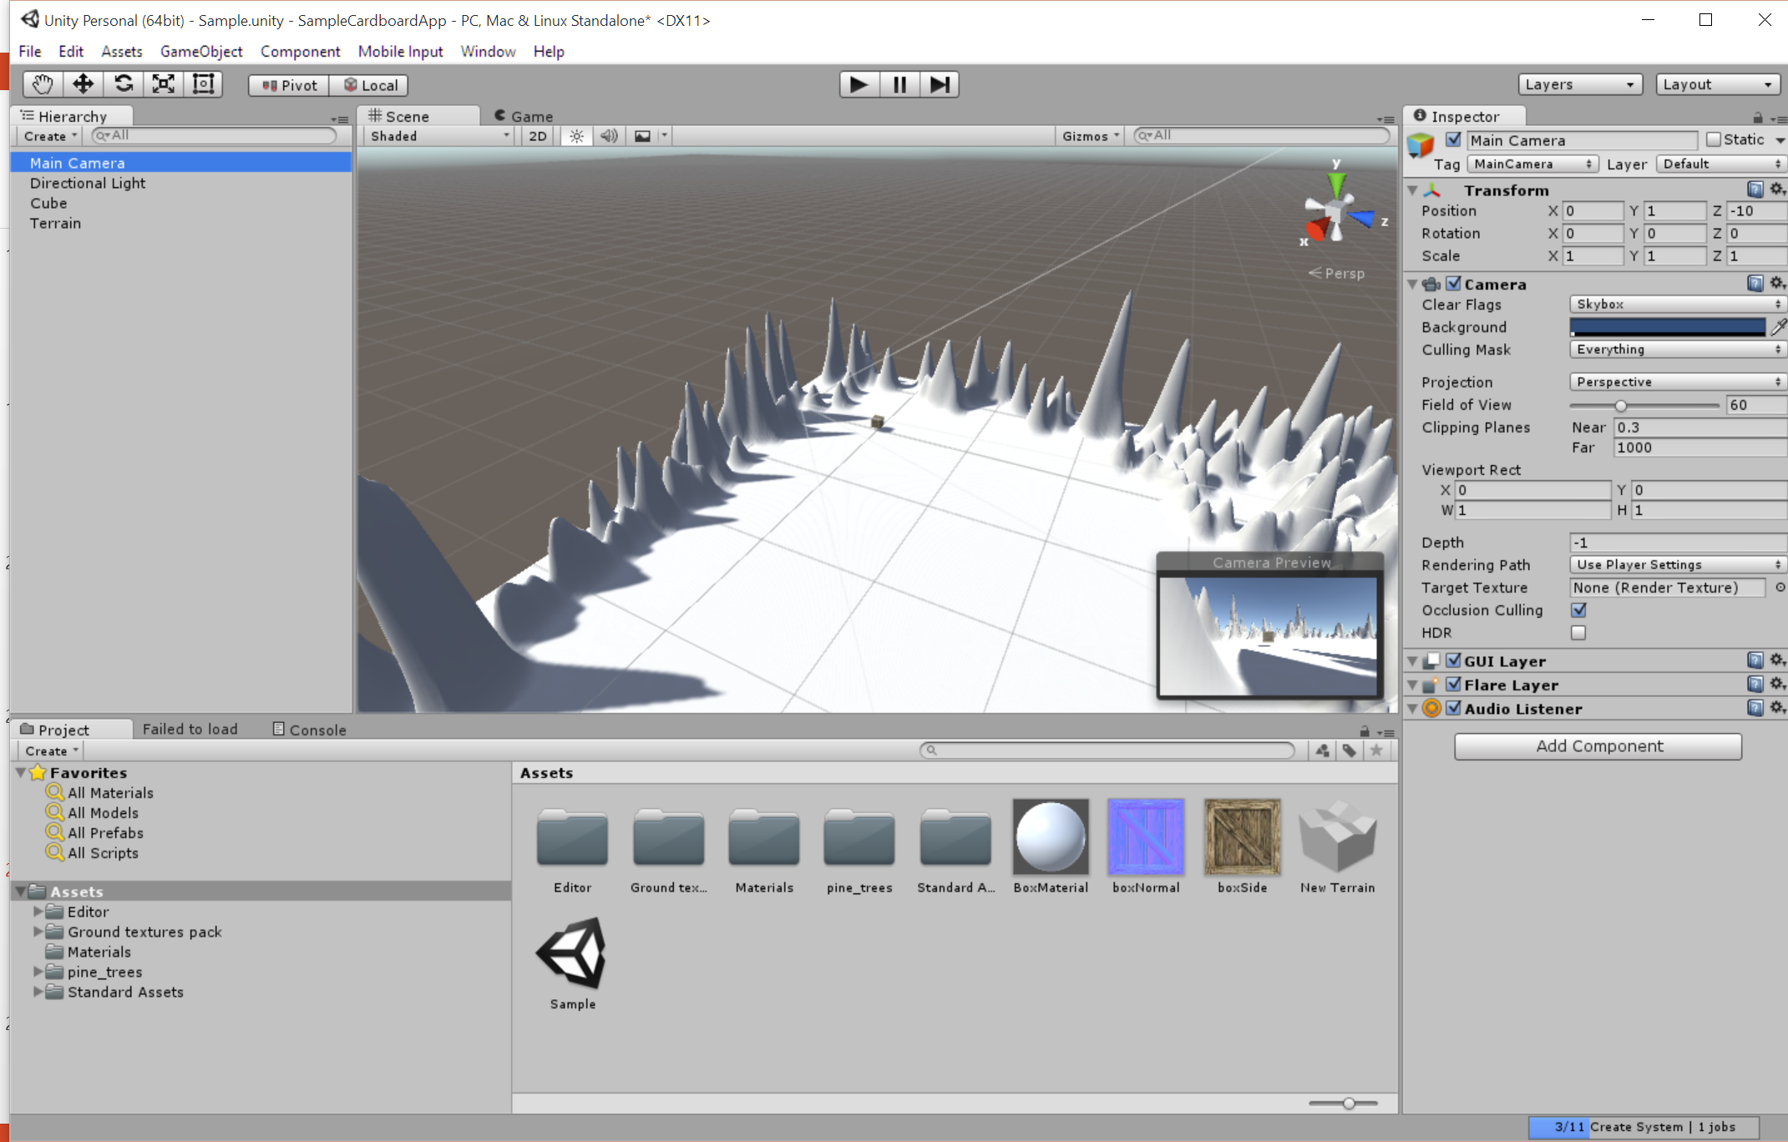
Creating a Terrain
Under Create, choose 3D Object and pick Terrain
Paint height by selecting a brush in the Inspector and clicking + dragging over the terrain mesh in the editor
Different brushes = different look!

Slide 23
Adding a Terrain Texture
The Unity Standard Asset package includes some textures to use on terrains. You can also find additional textures in the Asset store.
Select the terrain in the editor window
Click the small paint brush in the Inspector window
Select ‘Edit Textures’ and pick ‘Add Texture’
Choose a texture and it’s normal map
Click “Add” when done
The first texture you choose will apply to the entire map. You can then add additional textures and paint specific locations where you want them to be different using the same technique above.

Slide 24
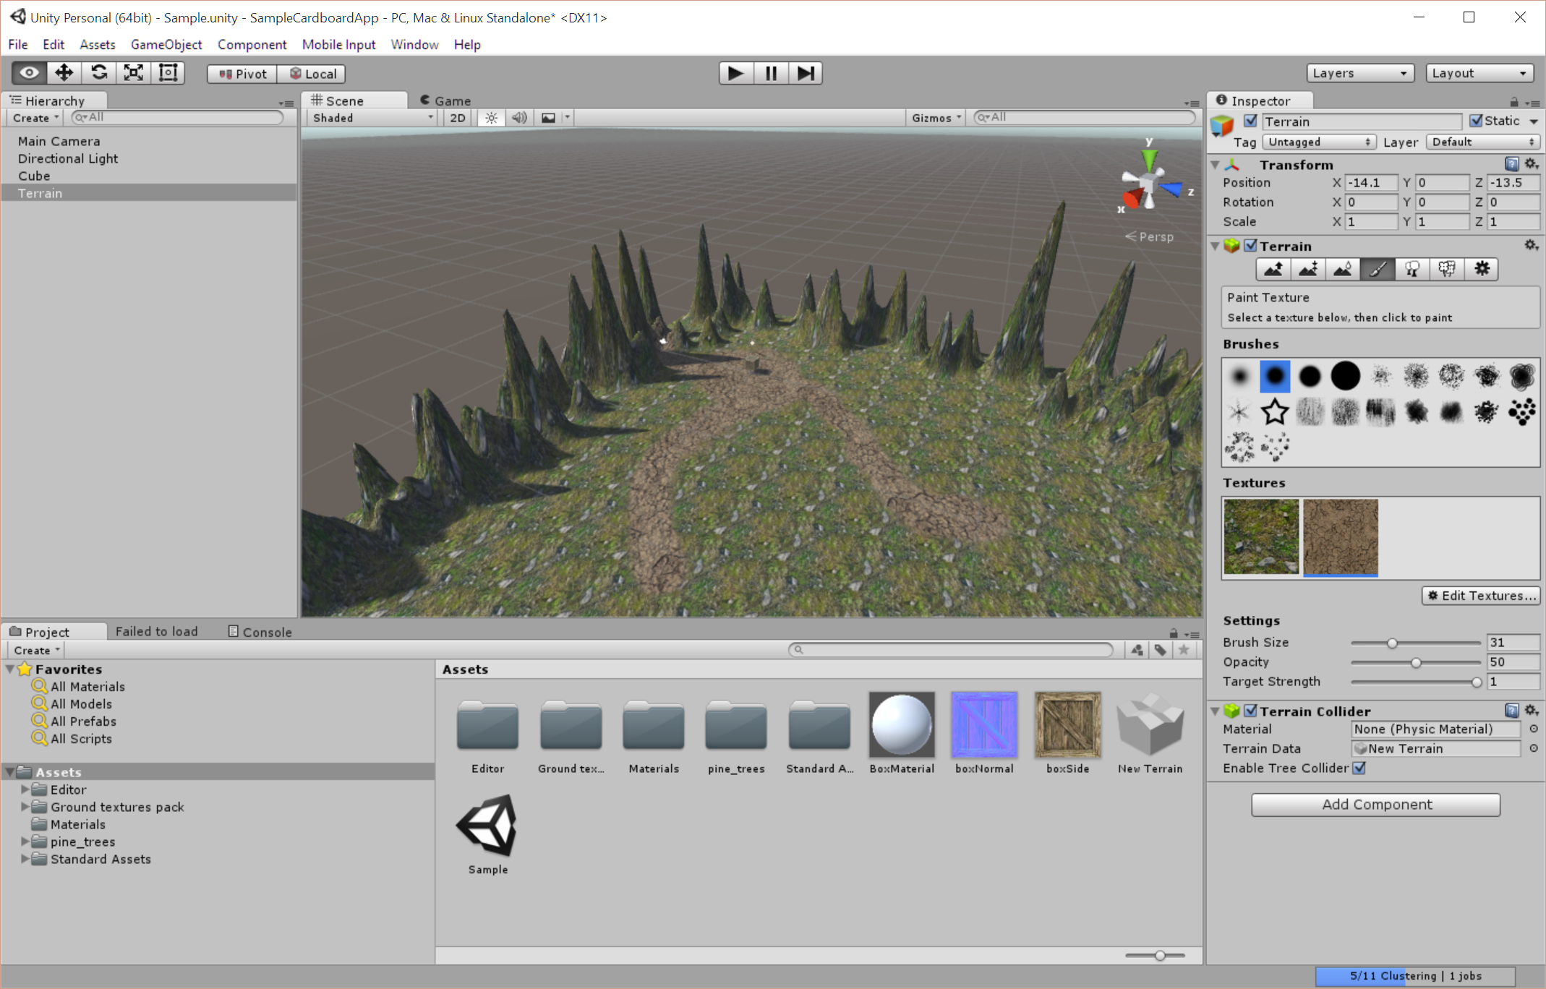

Slide 25
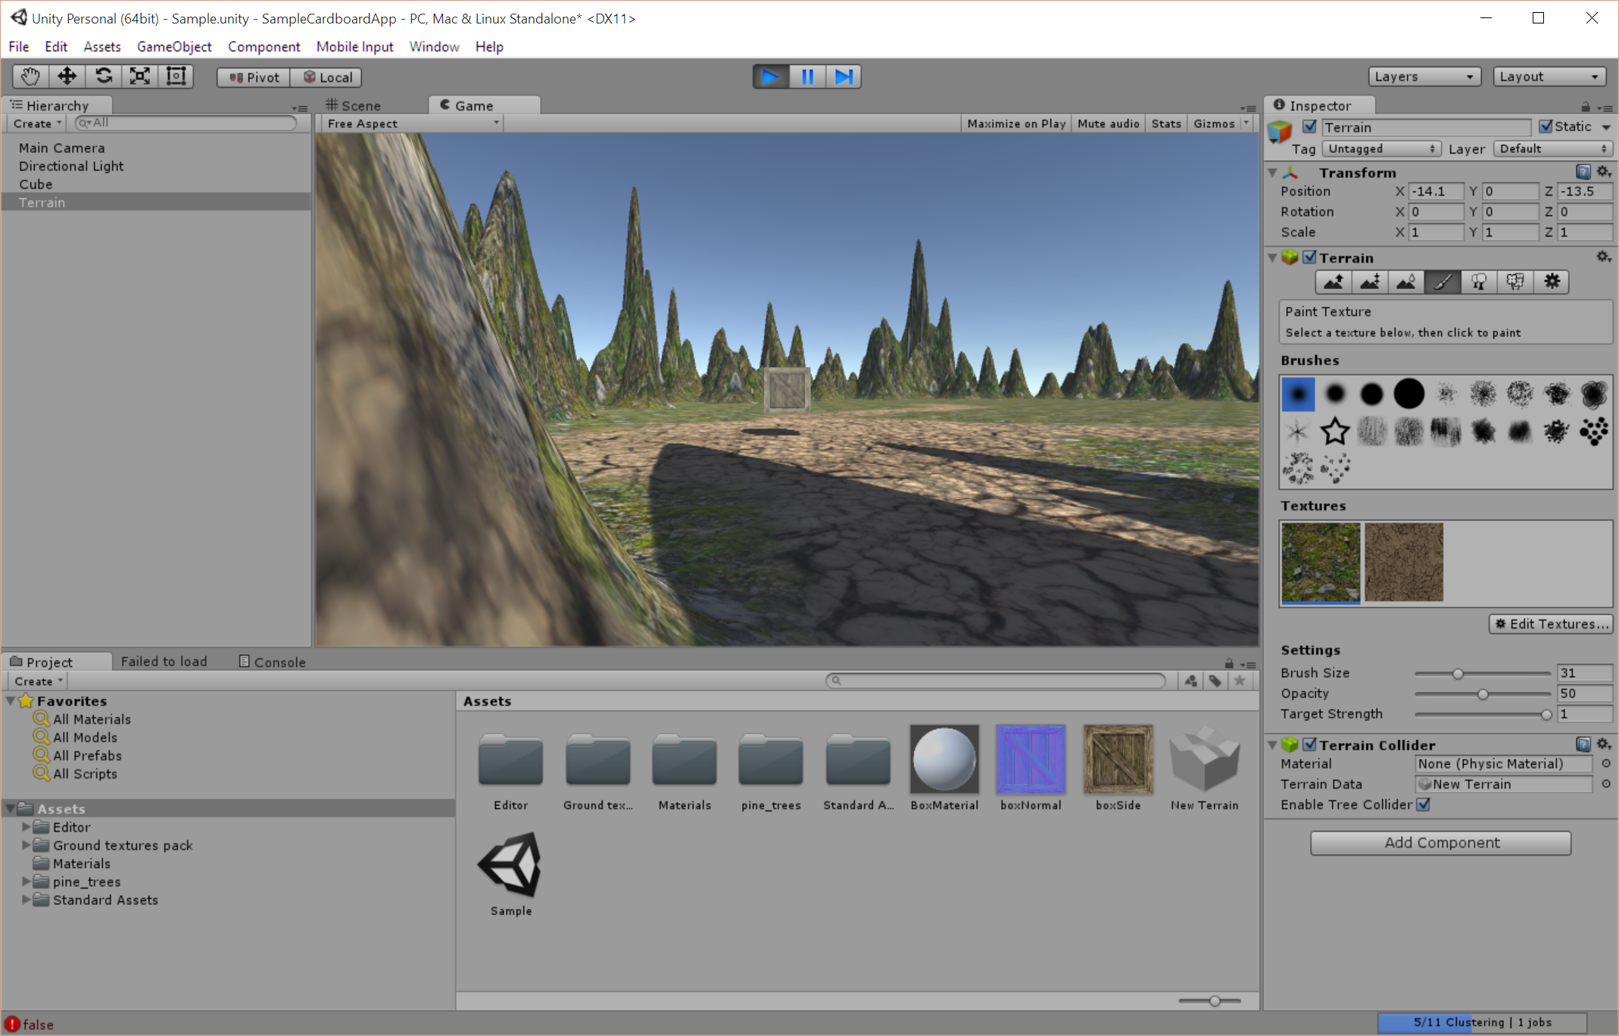

Slide 26
Adding Trees
Trees can be actual trees or other objects that you wish to add in large quantities to your terrain.
Select the button shaped like trees on the Inspector window
Choose ‘Edit Trees’ then ‘Add Tree’
Click the small circle by the empty box and choose your desired tree
Click ‘Add’ to save them
Paint the trees onto your terrain by dragging the brush, or choose “Mass Place Trees” to fill up trees over your terrain

Slide 27
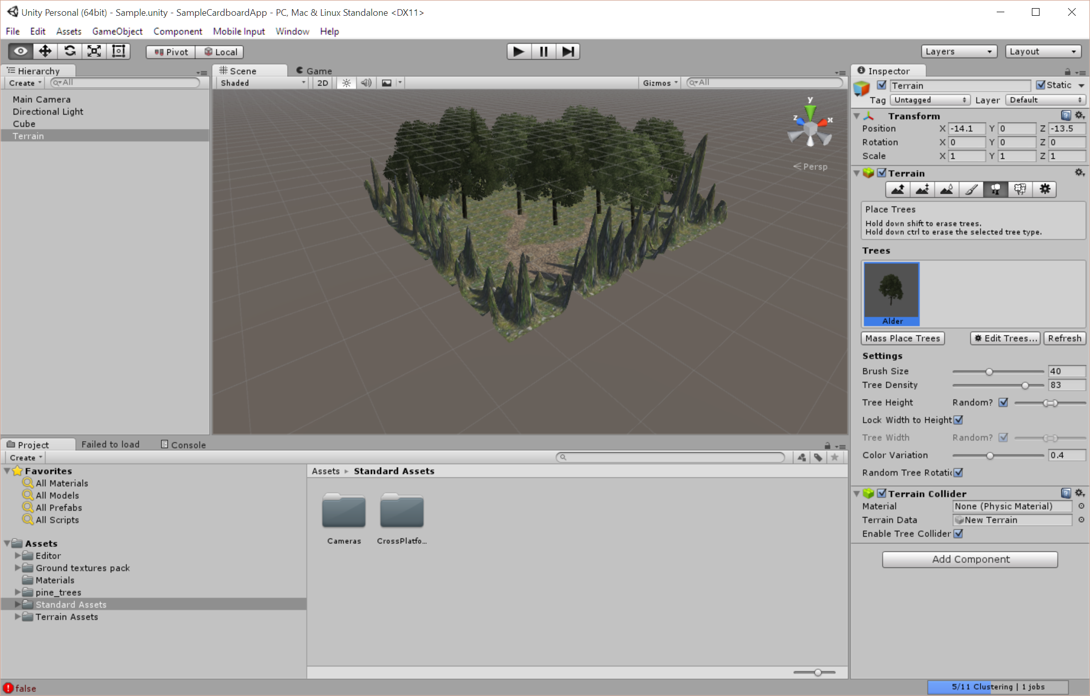

Slide 28
Adding Grass & Plants
Grass objects can be painted onto the terrain similar to how trees are placed, but with some different properties
Select the button in the terrain Inspector panel with flowers on it
Click ‘Add Detail’
Create your detail and grass objects
Paint them onto the terrain like the trees
Use sparingly! Grass is rendered individually and takes up a lot of processing power to manipulate and show effects

Slide 29
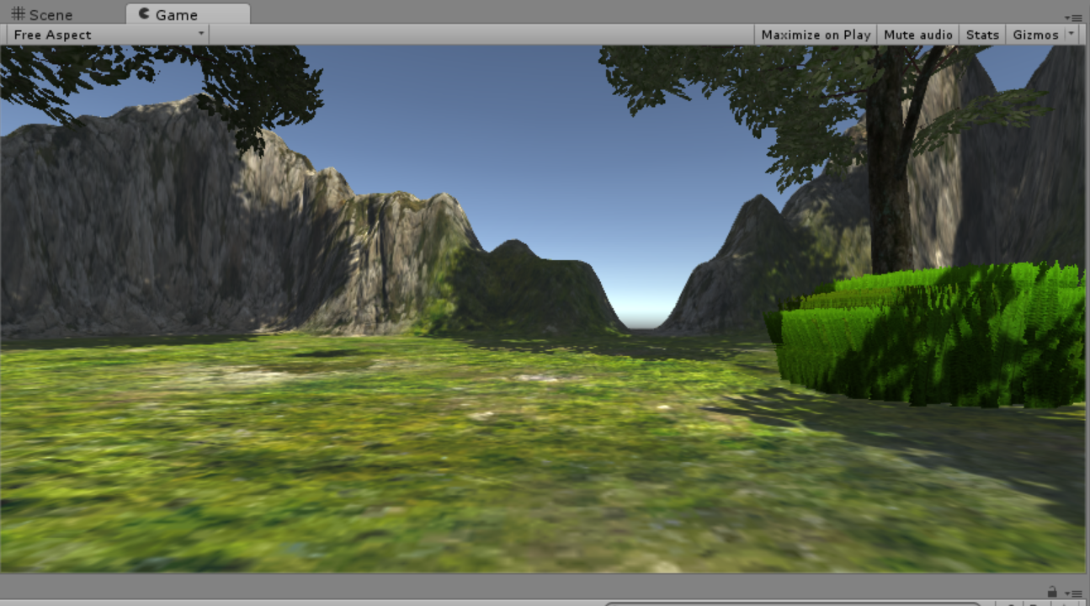
Fern Rendering Example

Slide 30
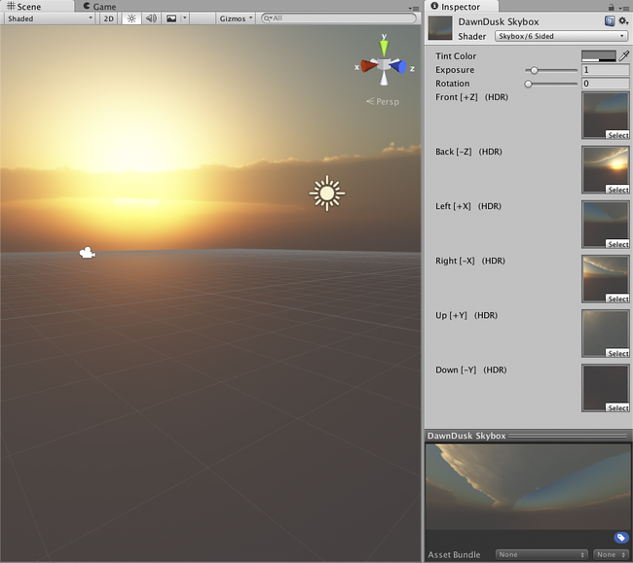
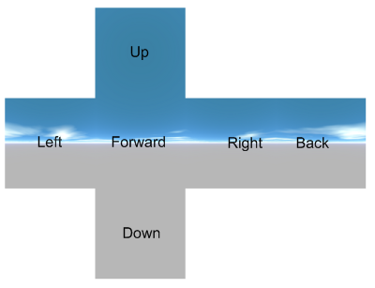
Skyboxes
Skyboxes are wrappers that surround your entire scene outside of your terrain with a visual representation of the sky. You can find these on the Unity Asset store or create your own from a series of 6 images

Slide 31
Interior Environments
When building an environment that is set indoors, you will build out the scene with primitive shapes (cubes, etc.) instead of the terrain builder
You can save combinations of materials and shapes in prefabs to prevent duplication of work

Slide 32
Adding VR
The Basics of VR Development in Unity

Slide 33
VR Development Kits
Oculus SDK (Desktop, Mobile): Build for the Oculus Rift. Windows only. Unity / Unreal plugins
SteamVR (Desktop): Build for HTC Vive, but support for Oculus too
Cardboard SDK (Mobile): Build for mobile phones
We will focus on the Cardboard SDK, but development principles for each platform are generally very similar

Slide 34
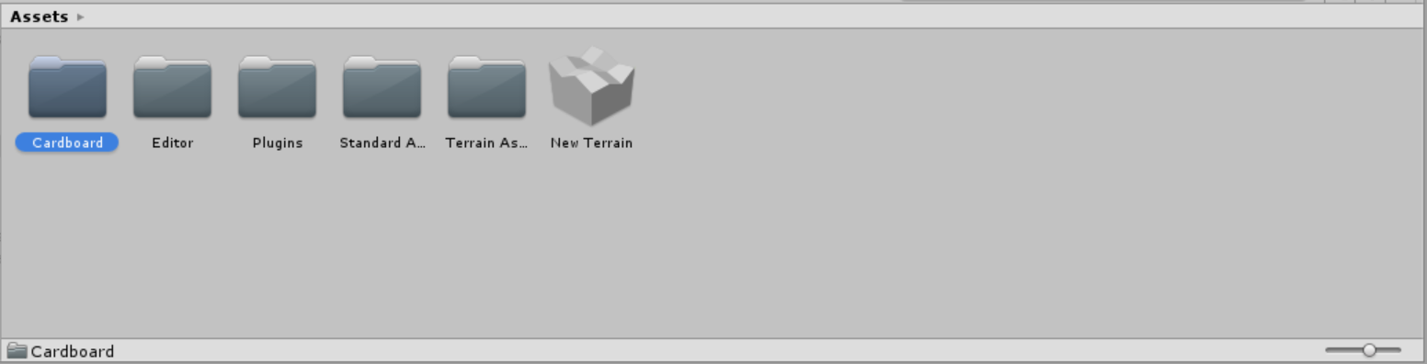
Cardboard SDK for Unity
Download the Unity plugin from Google here
Double click the Unity plugin to open Unity and install the assets
You should see a ‘Cardboard’ folder under the Assets tree

Slide 35
The Cardboard SDK Components
Cardboard Adapter: Prefabs to add to an existing model that you may have already created for your character. Contains left and right cameras to render stereoscopically
Cardboard Head: The prefab used to contain the adapter with multiple cameras. This separates out the logic of the rendering (done by the cameras) and the look/update behavior (head)
Cardboard Main: The prefab that contains the setup for creating a Cardboard viewer. You can begin with this if you are building for Cardboard from scratch and do not have an existing character with scripts to re-create

Slide 36
Creating the Cardboard Viewer
Delete the Main Camera from your scene
Drag the Cardboard Main prefab from the Assets folder into the scene
Press play to see your stereoscopic rendering!

Slide 37
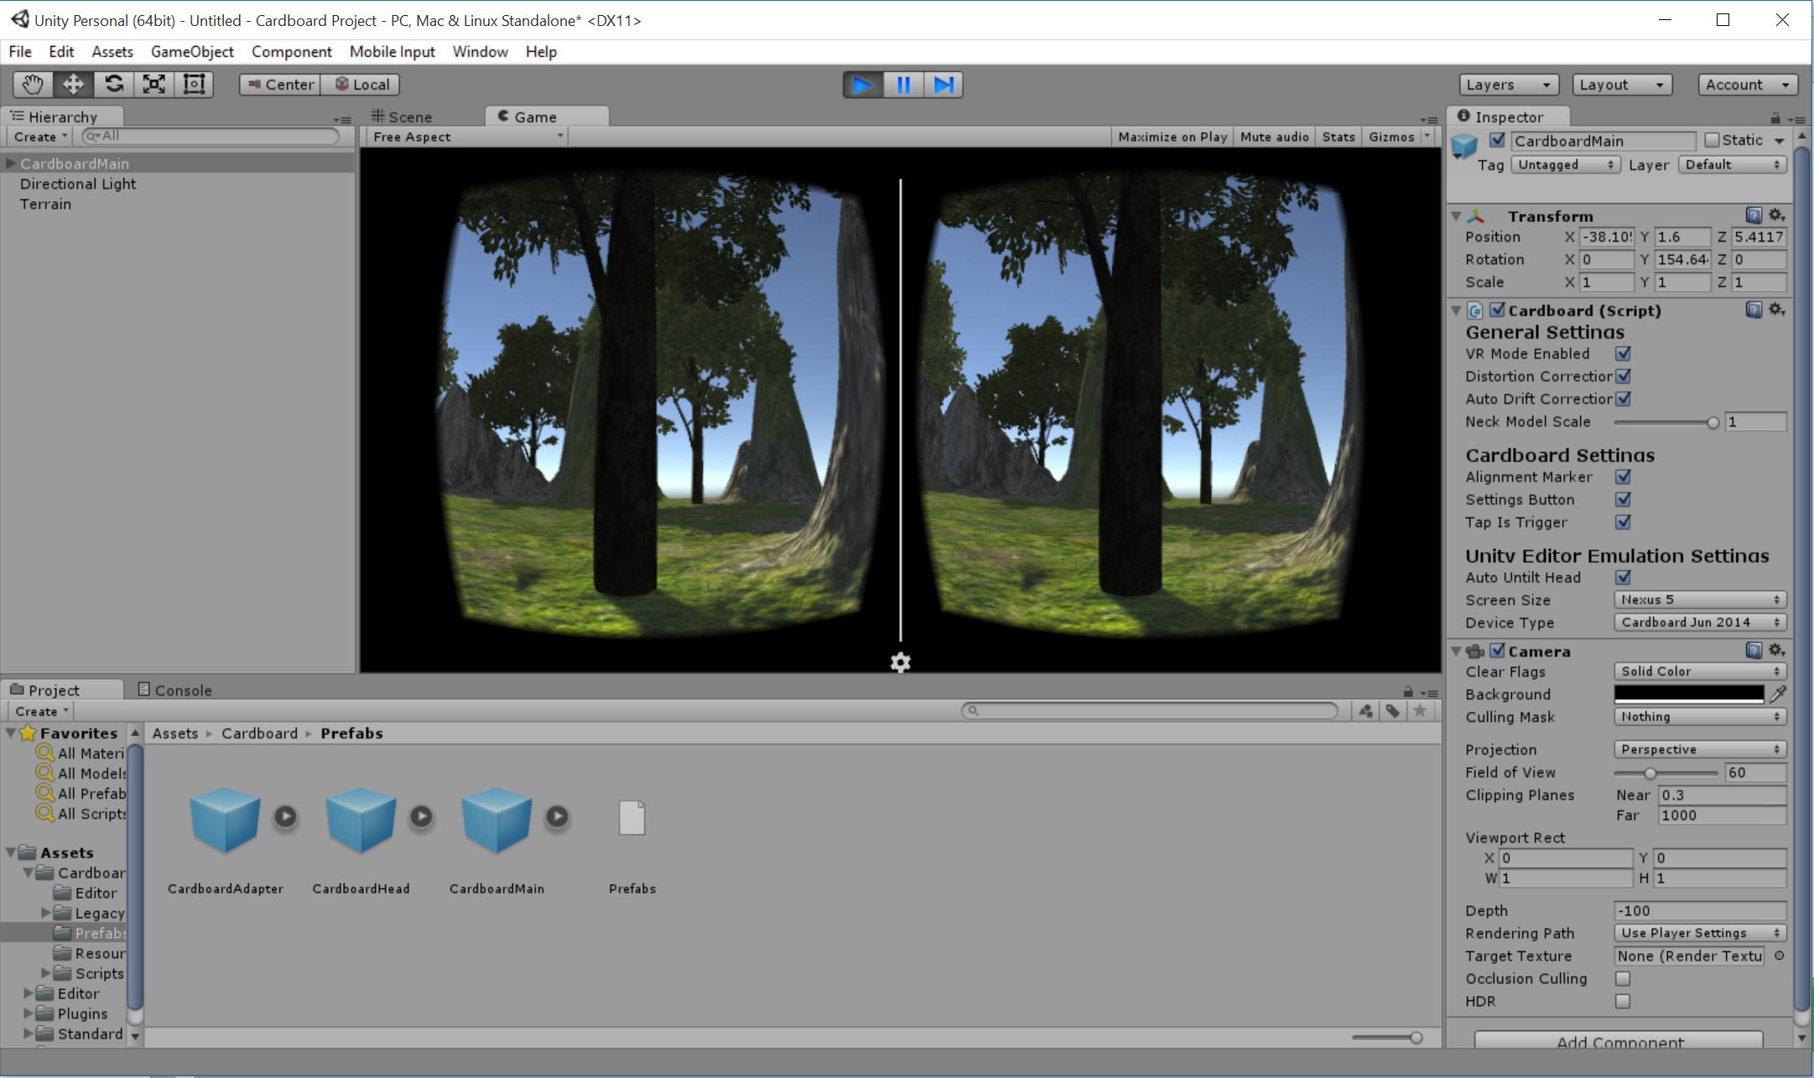

Slide 38
Testing in Unity
You can mimic some of the behaviors of your phone with the following:
Look Around: Alt + Click + Drag
Tilt Phone: Ctrl + Click + Drag

Slide 39
Movement
To include movement in your scene (be careful with how this is done in VR!) that can be controlled by the player, you will need to attach a ‘Character’ element to your camera.
Add a First Person Controller to your scene
Delete the camera included in the character controller
Replace with a Cardboard Main prefab to serve as the player controller

Slide 40
User Interaction

Slide 41
Refresher: Mobile VR Input
Designing VR apps with user input means considering how to approach the variety of devices that players may have
Some users may have peripheral devices that enhance an experience
Decide if your application needs input:
Meditation apps
Simple ‘movies’
Storytelling environment
Get creative!
Experiment into voice controls, ‘On Gaze’ interactions

Slide 42
Basic VR Input
Cardboard Magnet Trigger
Bluetooth Controllers
Provides a simple “On Click” mechanism similar to a mouse
Great for trigger-type interactions
Follow gaze
Can broaden for different input behaviors depending on things like where the user is looking
Provide a wider range of different behaviors
Allow for better motion control and character control for movement
Support more complex game mechanics
Downside: May need to customize for different types of controllers

Slide 43
Cardboard Trigger Interactions
Events that happen within your scene require an “Event System” item – this is a component that will handle clicks and other interactions
The objects that cause the various events will need an “Event Trigger” component
This approach can be used for UI elements, such as button clicks, or for objects within the scene

Slide 44
Add an Event System for Cardboard
Under your scene hierarchy, click ‘Create’ -> ‘UI’ -> ‘Event System’
Select ‘Add Component’ -> ‘Gaze Input Module’
On your Main Camera (under Cardboard Main object), select ‘Add Component’ -> Physics Raycaster
For game objects that you want to add a behavior to, add an ‘Event Trigger’ by going into the Inspector for the item
Choose ‘Add Component’ -> ‘Event Trigger’

Slide 45
Vanishing Act!
We are going to create a very short script that we can use with our Event System. This script will cause the object “clicked” on with the Cardboard trigger to disappear.
Under Assets, right click and choose ‘Create’ -> C# Script
You can use any editor you’d like with Unity – by default, Unity comes with an editor called ‘Mono Develop’, but I like to use Visual Studio since it has a few more debugging capabilities

Slide 46
Script Basics
Each Unity script will have two methods by default:
Start() -> Called the first time the scene is loaded
Update() -> Called once every frame
Scripts can have public variables, which can be modified by other game objects, or be self-contained
Add scripts to objects through the Inspector panel
There are additional methods that Unity will recognize (example: OnMouseClick() )

Slide 47
Our Script
// Delete is called on trigger pull
public void DeleteOnTrigger()
{
GameObject.Destroy(gameObject);
}

Slide 48
Set an action for Event Triggers
On your Event Trigger for your specific object, click ‘Add New Event Type’
Choose the desired event type (such as “Pointer Click” for a click / trigger pull)
Under ‘List is Empty’, click the plus sign
Click the circle next to the empty box and select the object (make sure you attached your script with your function!)
On the drop down, find the desired script and the function you want to call

Slide 49
Adding a Gaze Indicator
You can add an object to be used by the Event System as a ‘Gaze Tracker’ that shows where the current pointer location is.
Under your ‘Cardboard Head’ object in the hierarchy, add a capsule or sphere
Set the object properties to have a Z-index value that is ~5 units away from the head and .1 scaled on X, Y, and Z coordinates

Slide 50
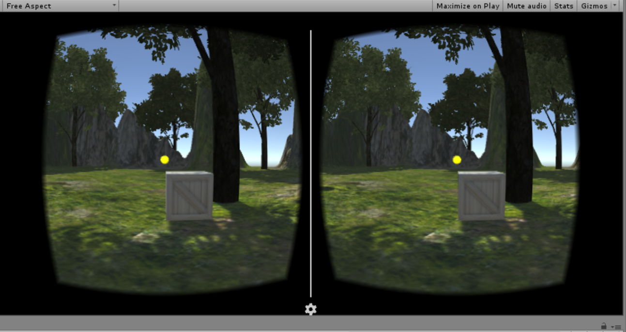

Slide 51
Final Notes

Slide 52
Gameplay Considerations
Character Movement: How do you want your user to move throughout your scene? Do you even want to allow movement in your game? Keep in mind that with VR, not all headsets will have an easy way to support moving around
Challenges: Are you building a game with challenges for a player to figure out? Or is your goal more experiential in nature?
Environment Design: Do you want your game to feel as though it takes place in a realistic environment, or do you want to create a surreal environment that feels totally different than the real world?

Slide 53
Up Next!
We will take a 30 minute break before moving on to the next section
After the break, we will walk through the materials we just covered together as a class to get the fundamentals of Unity & Cardboard development!

